Slide 1

EECS Security Whirlwind Tour
Part 1: Linux Systems Administration
Ben Roose
Electrical Engineering and Computer Science Dept. Systems Administrator
ben.roose@wichita.edu
Notes:
Thank you for being here
INTRODUCE Me and Job
ASK QUESTIONS
CLICK:
We are mainly going to be talking about the security of the Linux systems I run and some specific items which crop up!

Slide 2
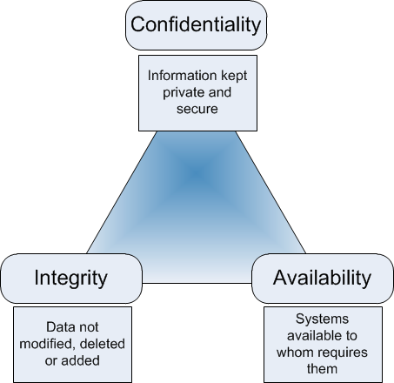
Fundamentals of a SysAdmin
It all boils down to the CIA Triad!
From: Geraint Williams Blog “CIA & InfoSec” (9 Sep, 2012)
Notes:
Quick run down of what we will talk about over the next 40 minutes!
Overall is the CIA Triad (Dr. Jadliwala)
Confidentiality = privacy of users and their data
Integrity = accuracy and trustworthiness of that data
Availability = making sure users can access that data

Slide 3

What are we talking about?
User Security: the weakest link in the chain?
Network Security: Firewalls and restrictive policy
Access Security: The many functions of SSH
Notes:
Quick run down of what we will talk about over the next 40 minutes!
Overall is the CIA Triad (Dr. Jadliwala)
Confidentiality = privacy of users and their data
Integrity = accuracy and trustworthiness of that data
Availability = making sure users can access that data

Slide 4

Computers, Computers, Computers
Microsoft Windows on the desktop
Private single user client systems
Traditional applications
Only turned on when user needs to work
Limited “pre-packaged” security for user/administrator
Possible high risk if used within insecure infrastructure
Linux Servers in the data center
Multi-user and “public facing” (remotely accessible from Internet)
Specialist applications and functionality
Needs to be “available” all the time (24/7)
Requires user/administrator to secure system
Possible high risk if system itself is insecure
Notes:
BEN DISCUSS EACH POINT
Windows boxes
Q: Who has used Windows? Who runs Windows updates?
Traditional application installation and maintenance and Windows updates (talk about past job at Health Professions running ~500 Windows boxes!)
Q: Who has installed software on Windows?
Security is limited to pre-packaged anti-virus and anand Windows updatesti-malware software
CLICK: LINUX – running these servers is what takes up most of my time here in EECS!!
Q: What does Linux run on? Who has installed software on a Linux computer?
Available = redundant power supplies and air con!
Linux management (administration) requires me to know how to secure each server.

Slide 5
User Password Security...or lack of it!
Required criteria to control user password selection
Time limit for password expiration (every 3 months at WSU)
Minimum or maximum password length (8-16 characters at WSU)
Numbers or special characters (1 number/no special char at WSU)
Upper and lowercase letters (not required at WSU)
No previous password allowed (this is true at WSU)
Password selection criteria causes problems for many users
Password generated becomes too complex (and is written down)
  Example: Ld1H1P3s7pYD3h
Password generated becomes too simple (and is easily guessed)
  Example: password2016
Notes:
BEN DISCUSS EACH POINT
Users are often the weakest link when it comes to security
Passwords are the most commonly used form of authenticating a user (and many passwords created by users are too weak)
At WSU we use a centralized password database for all our users (students, faculty, and staff) called LDAP (Lightweight Directory Access Protocol)

Slide 6
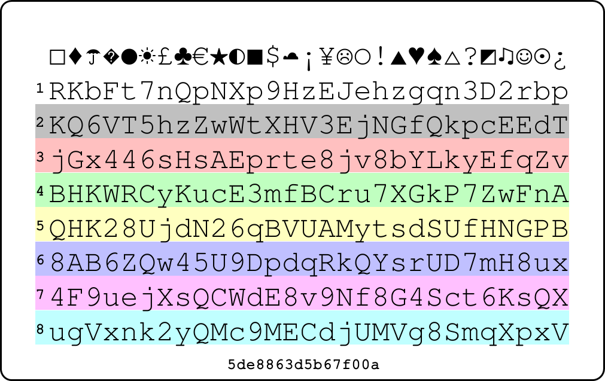
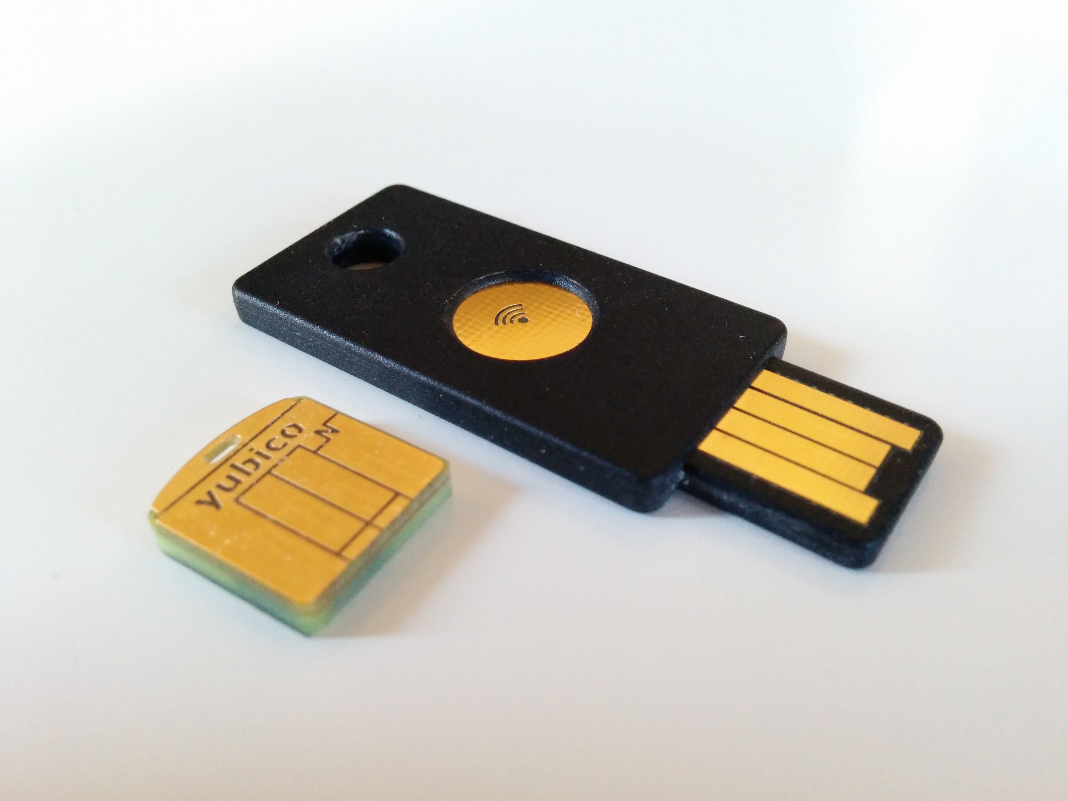
Good Methods for Strong Passwords
As a user you can build better password management:
Create a personal “algorithm” to build/generate complex passwords
  Mash words together (XKCD “horsebatterystaple” webcomic)
  Take first letter of each word from a line of film or TV dialogue
    Hint: Aliens | Password: “gomgo” → “g0Mg0” → “g0M....g0”
Use a password card or similar hint sheet (passwordcard.org)
Use different passwords for different systems or websites
Store passwords with secure password managers (lastpass.com)
Use a digital “key” (yubikey or RSA keyfiles)
Only access confidential accounts or websites from trusted systems
Notes:
BEN DISCUSS EACH POINT
Part of my job is to teach users (faculty and students) good security practices
EXAMPLE: A few days ago I had to explain to our new admin assistant why she could not leave a sticky note with password under her keyboard in main EECS office!
As a sysadmin I can help to keep user accounts secure:
Be vigilant with users regarding secure password management
Try to ensure accounts are accessed by only authorized users
CLICK WHEN TALKING ABOUT PASSWORD CARD

Slide 7
What are the servers used for?
Research Servers
Specialist functions and specialist hardware, i.e.
  “Crypto”: data storage (fileserver) and GIT software repository
  “Turing”: MatLab and Python heavy computation
  “Capplab”: CUDA parallel programming environment
Mainly physical “one-off” servers with remote access (HTTP/SSH)
Sometimes network isolation (hidden) is required
Customized configuration and firewalls
Varied subsets of user accounts – research students under a faculty
User research data could be classified or under patent restrictions
...BUT still needs to available to those authorized users 24/7!
Notes:
BEN DISCUSS EACH POINT
Research and then teaching

Slide 8
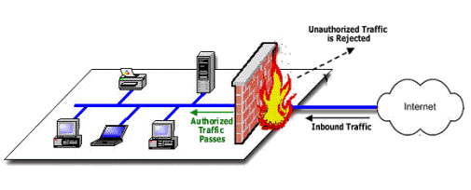
Hardening Networks Using a Firewall
Firewall as a network or computer system barrier
Gateway between local network (LAN) and external world (WAN)
Used on desktops, servers, and whole networks
Restrictive policy control: whitelisting or blacklisting
Can use “packet filtering” or “stateful inspection” rules
  Example: accept packets destined for port 80 from local network
From: Srikanth Ramesh – GoHacking “How Firewalls Work”
Notes:
BEN DISCUSS EACH POINT
Mention IP subnet ranges (public vs. private)
Firewall attempt to reduce network attacks (which you will find out about in a full network class)
Talk about restrictive policy control!
Q: Which is more secure, whitelist or blacklist?

Slide 9
Fun Firewall Demo
I need three volunteers!
Example 1:
  ACCEPT packet from external world to inside network
Example 2:
  DROP packet from external world to inside network
Example 3:
  REJECT packet from external world to inside network
Notes:
NEED CHOCOLATE AND GET THREE PEOPLE!

Slide 10
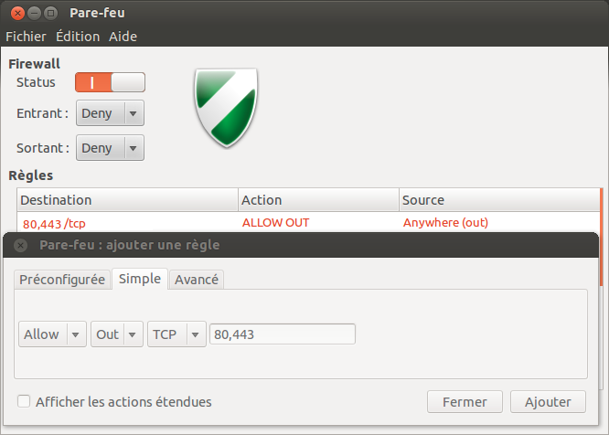
Using Firewalls in Linux
Graphical interface: Ubuntu Uncomplicated Firewall (gufw)
Used for desktop Linux systems
Similar to Windows Firewall
Simple to use, but limited functions
Command-line interface: iptables
Linux servers often uses iptables for firewall rule enforcement
Extremely configurable and powerful rule set
Complex command-line syntax to create rules
Can be scripted and automated for rule creation
Notes:
BEN DISCUSS EACH POINT
Research and then teaching

Slide 11
Scripting iptables
Example iptables command to allow incoming HTTP connections:
iptables -A INPUT -s 156.26.0.0/16 -m state --state NEW -m tcp -p tcp --dport 80 -j ACCEPT
Example input rule for Ben's iptables automated script using a json file:
{
"comment": "allow incoming HTTP from WSU wired public network"
"chain": "INPUT"
"source_ip": "156.26.0.0/16",
"destination_port": "80",
"target": "ACCEPT",
}
Notes:
Talk about syntax and how scripting makes it more user readable/writable (idea of literate programming from Donald Knuth at Stanford)
Q: HOW WOULD WE CHANGE THIS RULE TO ACCEPT HTTPS? (Port 443)

Slide 12
What are the servers used for?
Teaching Servers
Specialist functions but defined by computer courses taught in EECS
  mainly used for programming course assignments and labs
All servers are virtualized and identically set up (for load-balancing)
  kira, kirk, mccoy, riker, scotty, sisko, spock
Can be accessed using:
  thin-client terminals in our lab (LTSP)
  remote access from off-campus (SSH)
All EECS students and faculty need user accounts
Users may have limited experience with Linux systems
User data must be secure and available to each student (or instructor)
...AND still needs to available to all authorized users 24/7!
Notes:
BEN DISCUSS EACH POINT
Research and then teaching

Slide 13
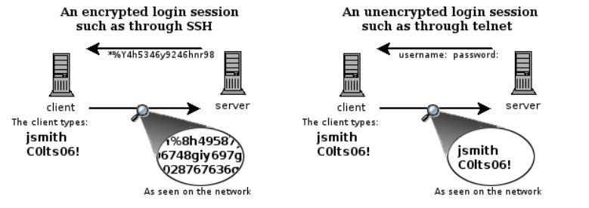
Secure Remote Access (SSH)
Secure SHell (SSH)
Client/server model: enables client secure access into remote server
Based on telnet, but encrypts all data between client and server
Communicates on TCP port 22 (default)
Linux and Mac: OpenSSH (www.openssh.org)
Windows: PuTTY, KiTTY, or MobaXterm (client only)
Notes:
So we've got these servers and we've got strong passwords. How do we access these servers?
Using SSH
According to the OpenSSH website, “it encrypts all traffic to eliminate eavesdropping, connection hijacking, and other attacks. In addition, OpenSSH provides a large suite of secure tunneling capabilities, several authentication methods, and sophisticated configuration options.”

Slide 14
Any remote access must be hardened!
sshd logfile (from server “spock” – Wed July 27th 2016):
Failed logins from:
5.189.151.139 (oldmx1.aspnet.hu): 2 times
41.222.90.21 (ptr-41-222-90-21-dsalaam.tz.bellafrica.net): 1 time
82.85.187.101 (static-82-85-187-101.clienti.tiscali.it): 2 times
113.21.228.166: 2 times
119.163.120.202: 2 times
185.93.185.239: 1 time
185.110.132.201: 4 times
187.141.70.67 (saargo.com.mx): 2 times
197.159.208.178 (WimaxUser-197-159-208-178.vipnet.ci): 2 times
211.144.95.195 (reserve.cableplus.com.cn): 6 times
218.65.30.92 (92.30.65.218.broad.xy.jx.dynamic.163data.com.cn): 6 times
218.83.155.86: 1 time
222.186.56.104: 7 times
Illegal users from:
undef: 69 times
41.222.90.21 (ptr-41-222-90-21-dsalaam.tz.bellafrica.net): 2 times
91.224.160.184: 5 times
113.21.228.166: 16 times
119.163.120.202: 17 times
185.93.185.239: 4 times
185.110.132.201: 16 times
197.159.208.178 (WimaxUser-197-159-208-178.vipnet.ci): 13 times
Users logging in through sshd:
c624j323: 192.168.1.166 (ltsp166.cs.wichita.edu): 1 time
D342e668: 192.168.1.162 (ltsp162.cs.wichita.edu): 1 time, 192.168.1.168 (ltsp168.cs.wichita.edu): 1 time
u692s926 192.168.1.167 (ltsp167.cs.wichita.edu): 1 time
u885a945: 172.27.2.241: 1 time
v272s779: 192.168.1.167 (ltsp167.cs.wichita.edu): 1 time
Notes:
So we've got these servers and we've got strong passwords. How do we access these servers?
Using SSH
According to the OpenSSH website, “it encrypts all traffic to eliminate eavesdropping, connection hijacking, and other attacks. In addition, OpenSSH provides a large suite of secure tunneling capabilities, several authentication methods, and sophisticated configuration options.”

Slide 15
Do not allow root account remote access!
sshd logfile continued (from server “spock” – Wed July 27th 2016):
Authentication Failures:
unknown (119.163.120.202): 17 Time(s)
unknown (113.21.228.166): 16 Time(s)
unknown (185.110.132.201): 16 Time(s)
unknown (197.159.208.178): 13 Time(s)
root (211.144.95.195): 6 Time(s)
root (218.65.30.92): 6 Time(s)
root (222.186.56.104): 6 Time(s)
root (185.110.132.201): 4 Time(s)
unknown (185.93.185.239): 4 Time(s)
root (113.21.228.166): 2 Time(s)
root (187.141.70.67): 2 Time(s)
root (5.189.151.139): 2 Time(s)
root (static-82-85-187-101.clienti.tiscali.it): 2 Time(s)
unknown (ptr-41-222-90-21-dsalaam.tz.bellafrica.net): 2 Time(s)
bin (197.159.208.178): 1 Time(s)
list (119.163.120.202): 1 Time(s)
root (197.159.208.178): 1 Time(s)
root (218.83.155.86): 1 Time(s)
root (ptr-41-222-90-21-dsalaam.tz.bellafrica.net): 1 Time(s)
unknown (91.224.160.184): 1 Time(s)
Invalid Users:
Unknown Account: 73 Time(s)
Unknown Entries:
service(sshd) ignoring max retries; 5 > 3: 2 Time(s)
4 more authentication failures;logname= uid=0 euid=0 tty=ssh ruser= rhost=91.224.160.184
service(sshd) ignoring max retries; 6 > 3: 1 Time(s)
Notes:
So we've got these servers and we've got strong passwords. How do we access these servers?
Using SSH
According to the OpenSSH website, “it encrypts all traffic to eliminate eavesdropping, connection hijacking, and other attacks. In addition, OpenSSH provides a large suite of secure tunneling capabilities, several authentication methods, and sophisticated configuration options.”

Slide 16
SSH: The Multitool of SysAdmins
Multiple connection authentication methods
  User entered text password (encrypted in transit)
  User-based private/public key pairs (RSA/DSA)
  Host-based private/public key pairs (RSA/DSA)
Secure file copying (scp) and file transfer (sftp)
Encrypted X11-forwarding (remote GUI applications)
Authentication agent forwarding/proxying (hardened SSH bastion)
Encrypted network tunneling (port forwarding)
For more on SSH: Google Search “The Black Magic of SSH” video
Notes:
Key pairs (asymmetric)
NOTE: Host proxying we will discuss later!

Slide 17
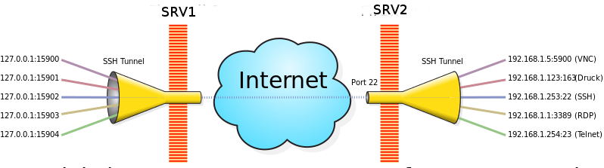
SSH Network tunneling
Encrypt any unencrypted network protocol using port forwarding!
From: Alberto Larripa – Sysadmin and DBA tips “VPS”
Notes:
Talk through how it works
Also mention that it allows a user to bypass gateway rules and locale restrictions
(ASK OSCAR TO GIVE HIS KUWAIT STORY!)

Slide 18
Tour and SSH Exercise!
Quick break then:
Tour of WSU Data Center (Jabara Hall 3rd Floor)
Tour of EECS Linux Lab (Jabara Hall 205/206)
Hands-on exercise in Linux lab covering SSH
Back here to talk about load-balancing and DevOps before lunch
Notes:
NEED CHOCOLATE AND GET THREE PEOPLE!

Slide 19

Thank you
Questions?
Ben Roose: ben.roose@wichita.edu

Slide 20



This work is licensed under the Creative Commons
Attribution-ShareAlike 4.0 International License.
To view a copy of this license, visit http://creativecommons.org/licenses/by-sa/4.0/.
Wichita State University

